Slide 1

An Explainable Header-Centric Framework for Large-Scale Semantic Table Interpretation and Data Quality Assessment
Marcelo Valentim Silva, Hannes Herrmann and Valerie Maxville
Curtin University
Perth, Western Australia
Australia

Slide 2
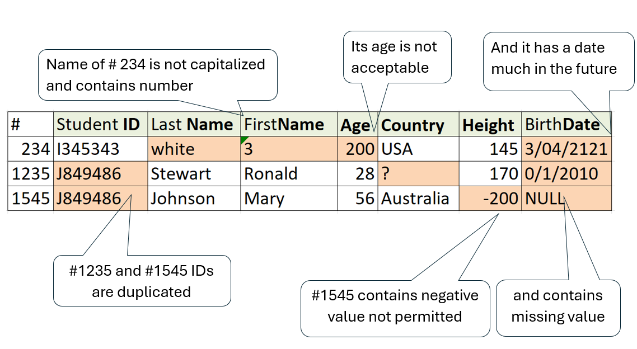
Real-world Data Quality Problems

Slide 3
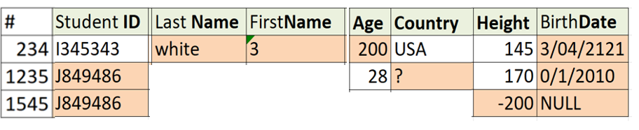
How to detect these issues automatically?

Slide 4






What about analysing Attribute labels/Column Headers?

Slide 5
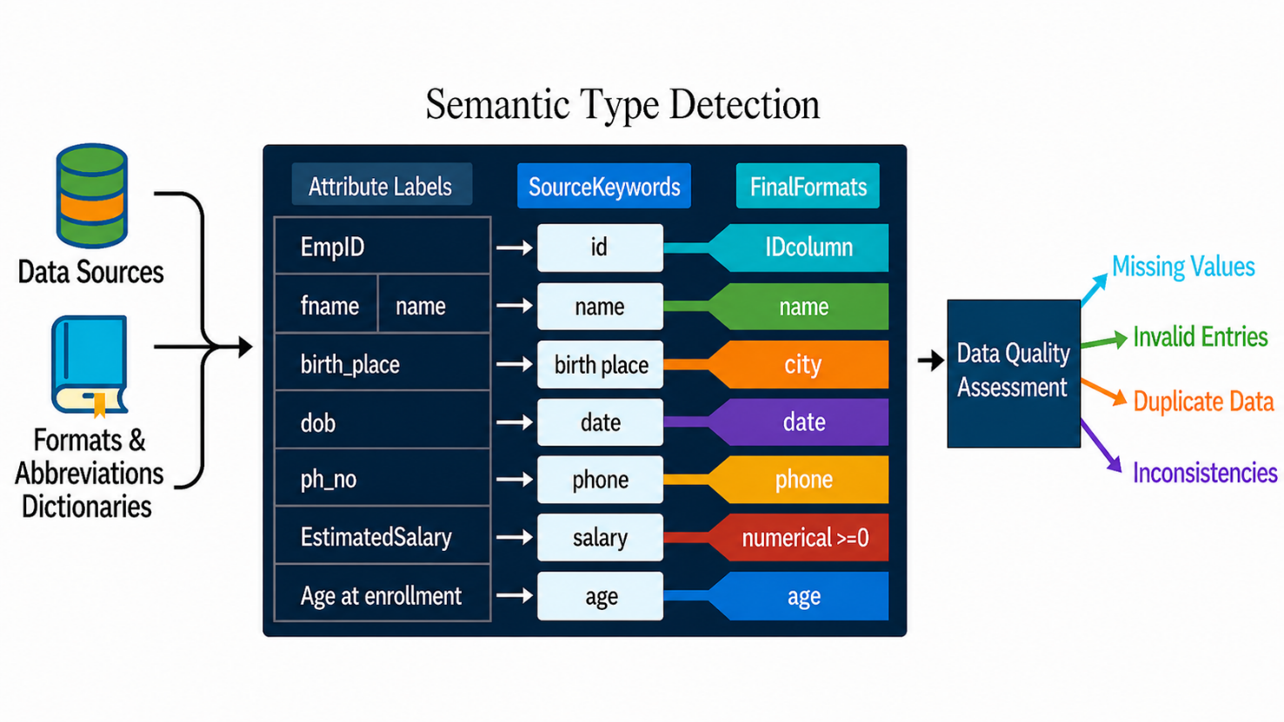
Approach
Generated with ChatGPT

Slide 6
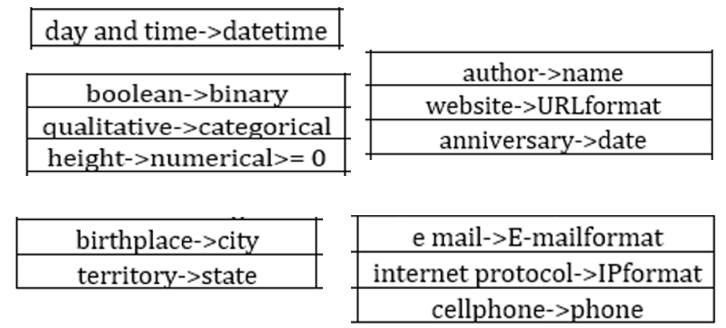
Key Concepts
Mappings in the Formats Dictionary

Slide 7
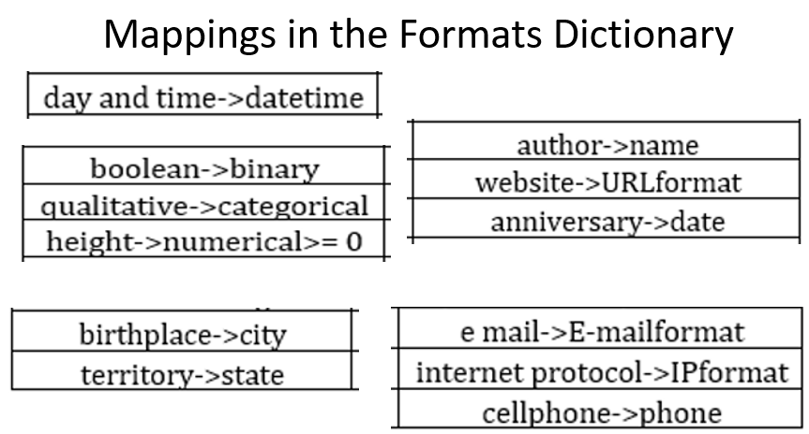
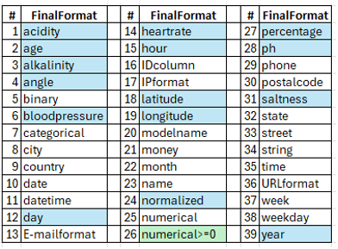
Key Concepts
2800 instances

Slide 8
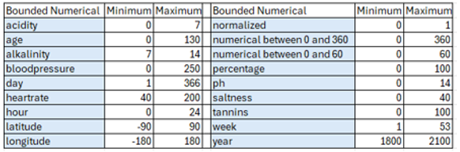
Key Concepts
39 FinalFormats
Bounded Numerical limits

Slide 9

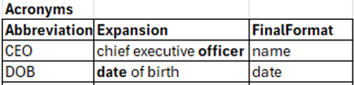

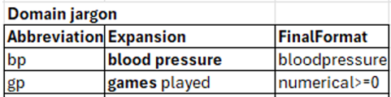

Key Concepts
1000 instances
Mappings from Abbreviations Dictionary to Formats Dictionary

Slide 10
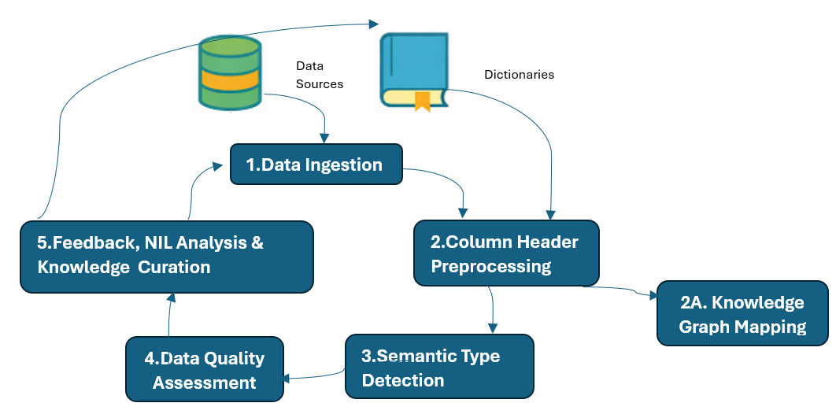
Architecture

Slide 11
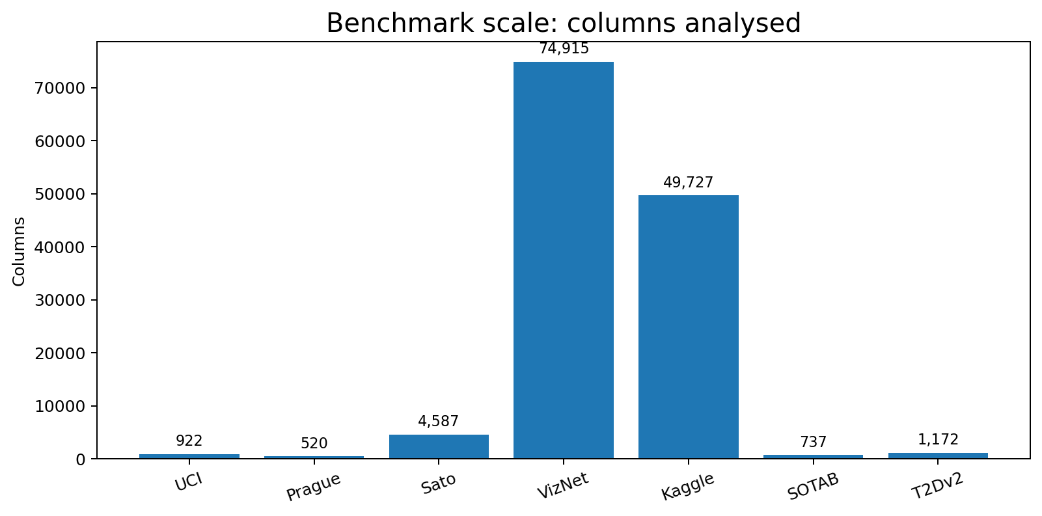
Evaluation

Slide 12
Preprocessing in STI: What is Missing
Many STI approaches use preprocessing to do: - Lowercasing - Tokenisation - String normalisation → Abbreviations and compressed labels remain unresolved

Slide 13
Knowledge Graph Mapping
How the mapping works:
Column headers are compared with KG labels using fastText embeddings and cosine similarity.
The KG term with the highest semantic similarity is selected as the best matching property or class.

Slide 14
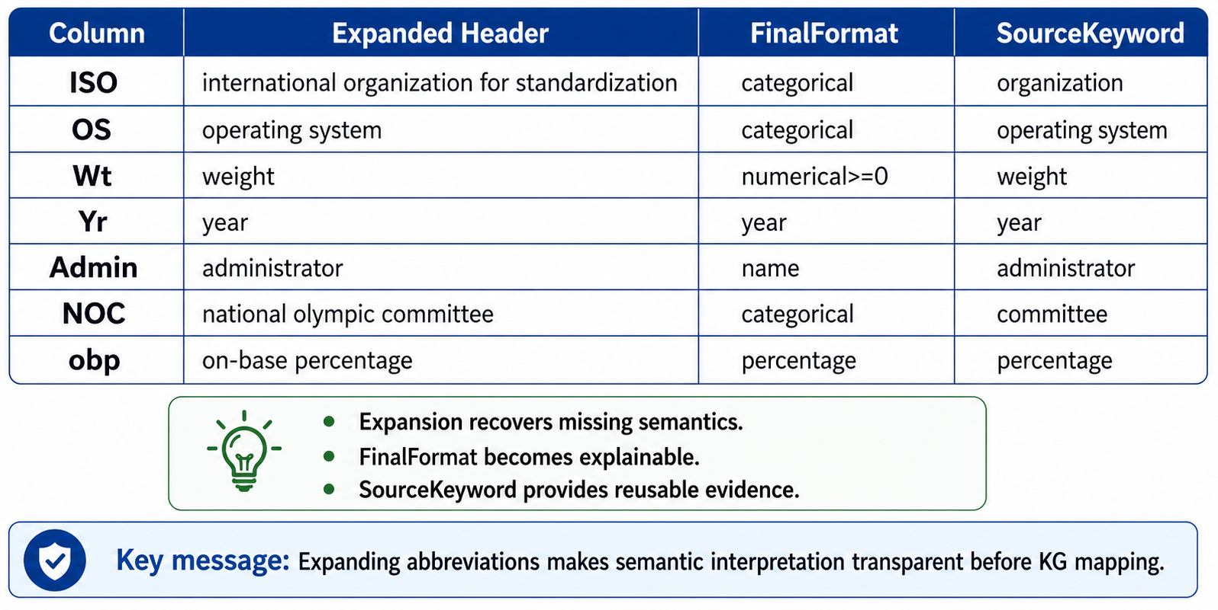
Abbreviation Expansion to FinalFormat and SourceKeyword
Generated with ChatGPT

Slide 15
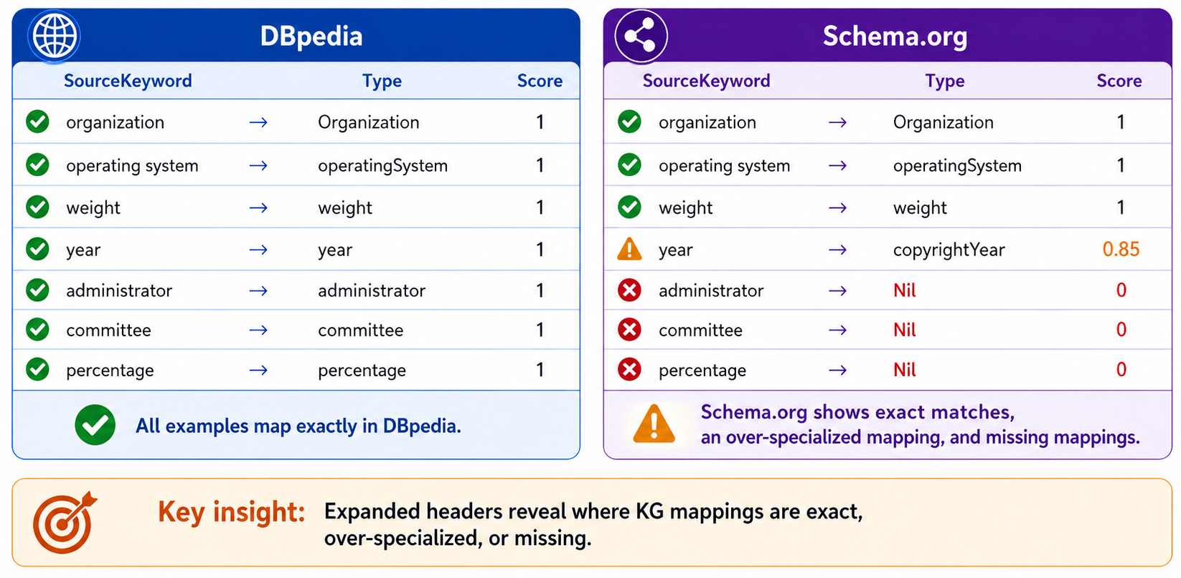
KG Alignment Outcomes after Header Expansion
Generated with ChatGPT

Slide 16
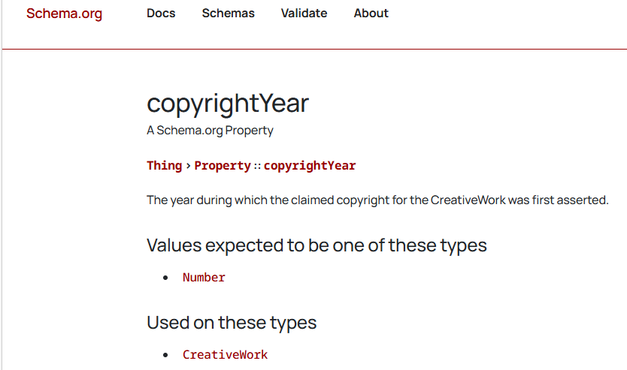
KG Alignment Outcomes after Header Expansion

Slide 17
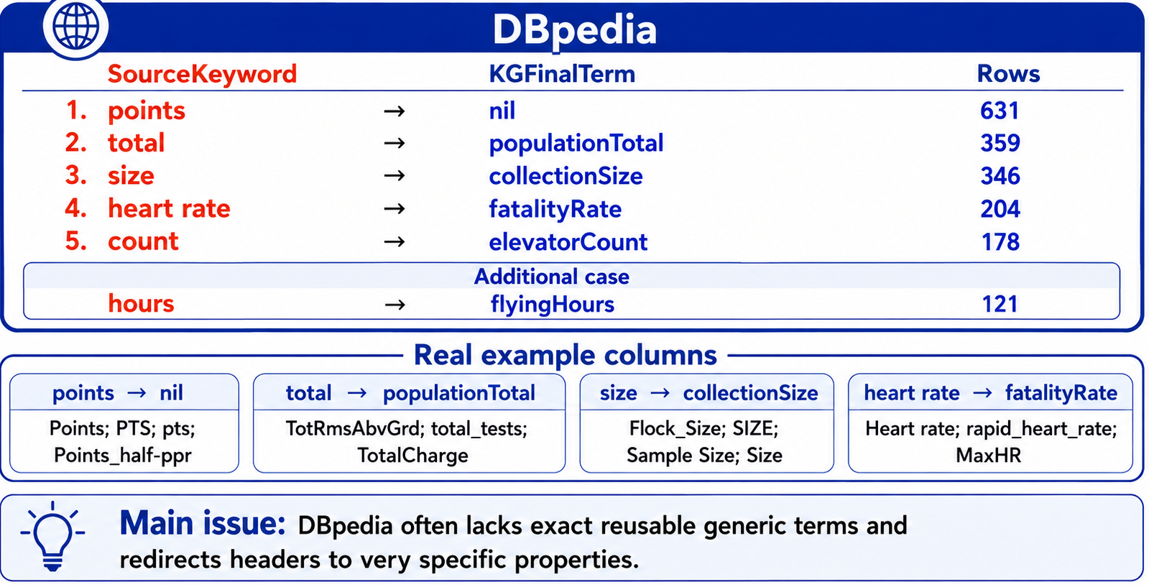
Frequent DBpedia Vocabulary Gaps and over-Specialized Mapping from SourceKeywords
Generated with ChatGPT

Slide 18
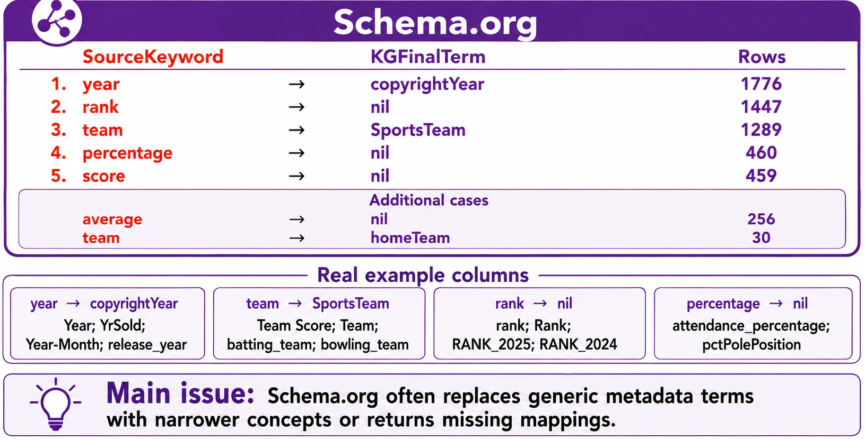
Frequent Schema.org Vocabulary Gaps and over-Specialized Mapping from SourceKeywords
Generated with ChatGPT

Slide 19
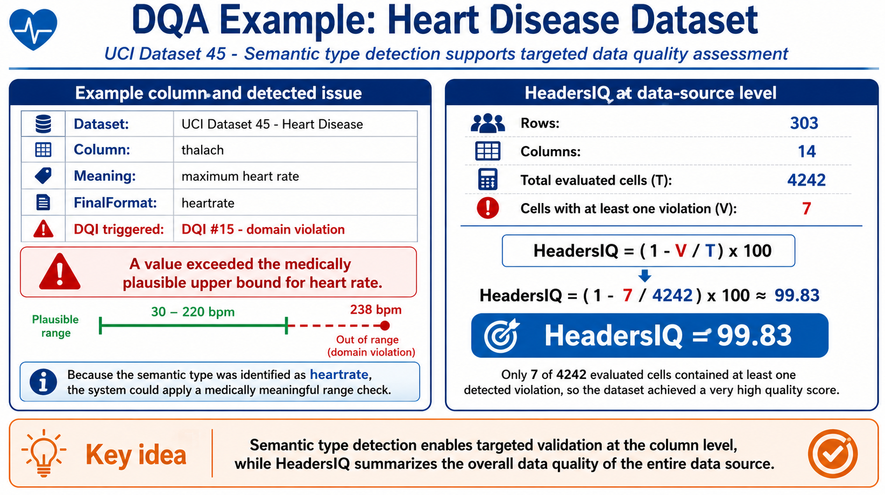
Generated with ChatGPT

Slide 20
Strengths
Explainability
Scalability
Abbreviation handling
HeadersIQ

Slide 21
Contribution to KG Quality
Improve data before KG construction
Support quality-aware pipelines

Slide 22

https://stock.adobe.com/259179999&h=750&w=1000&tbnid=lp3-4bdTht5Y8M&source=sa.im&tbnh=194&tbnw=259&usg=AI4_-kRh9sYkXtcV5K1g-R78YEweMVhYsg&vet=1&docid=f15zKOQzxWcsIM

Slide 23


https://stock.adobe.com/au/search?k=questions+and+answers&asset_id=86681903
marcelo.valentim@bcb.gov.br
Generated with ChatGPT

